Slide 1
FUN WITH CSS
Made by:
Yes Ansari,
Nédis Paes Barreto,
Laurian staicu

Slide 2
Training
We chose a YouTube video
Build a 5 element carousel

Slide 3
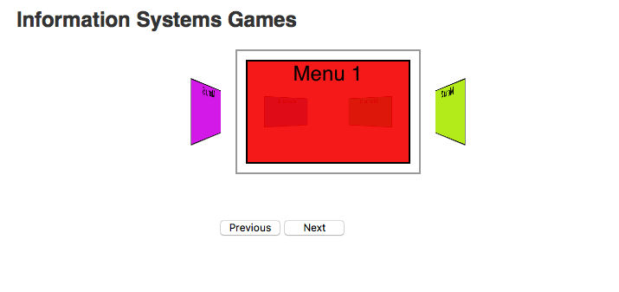
5 element training carousel

Slide 4
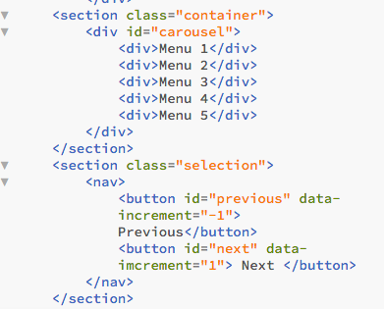

Slide 5
Using frame work carousel
The CSS quiz game
Based from the book example
We adapted the app to our requirements
Very good understanding of the code structure

Slide 6
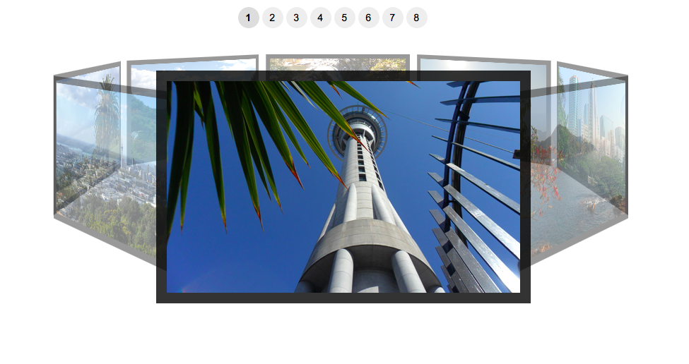
Original book application

Slide 7
Brainstorming and planning of the game
Quick meeting and planning of goals
Stating research
Gathering information for technical solutions
Assignment of tasks

Slide 8
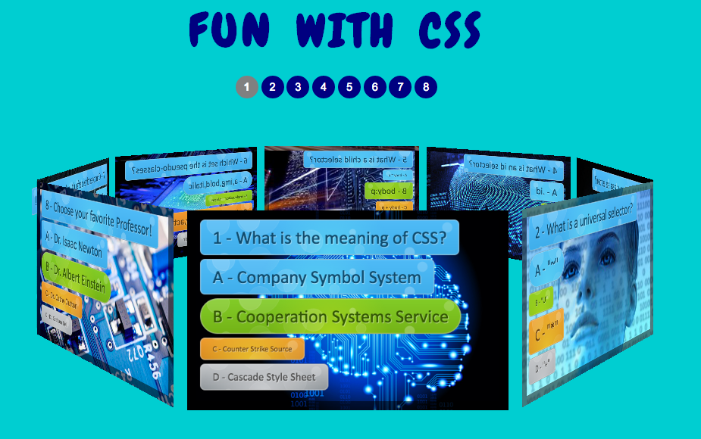
Final version of project

Slide 9
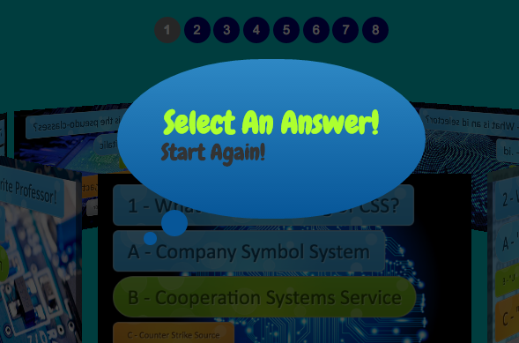
Using pure css to implement bubbles

Slide 10
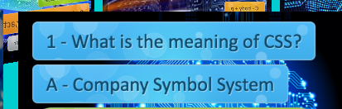
Using css library to implement fancy buttons

Slide 11
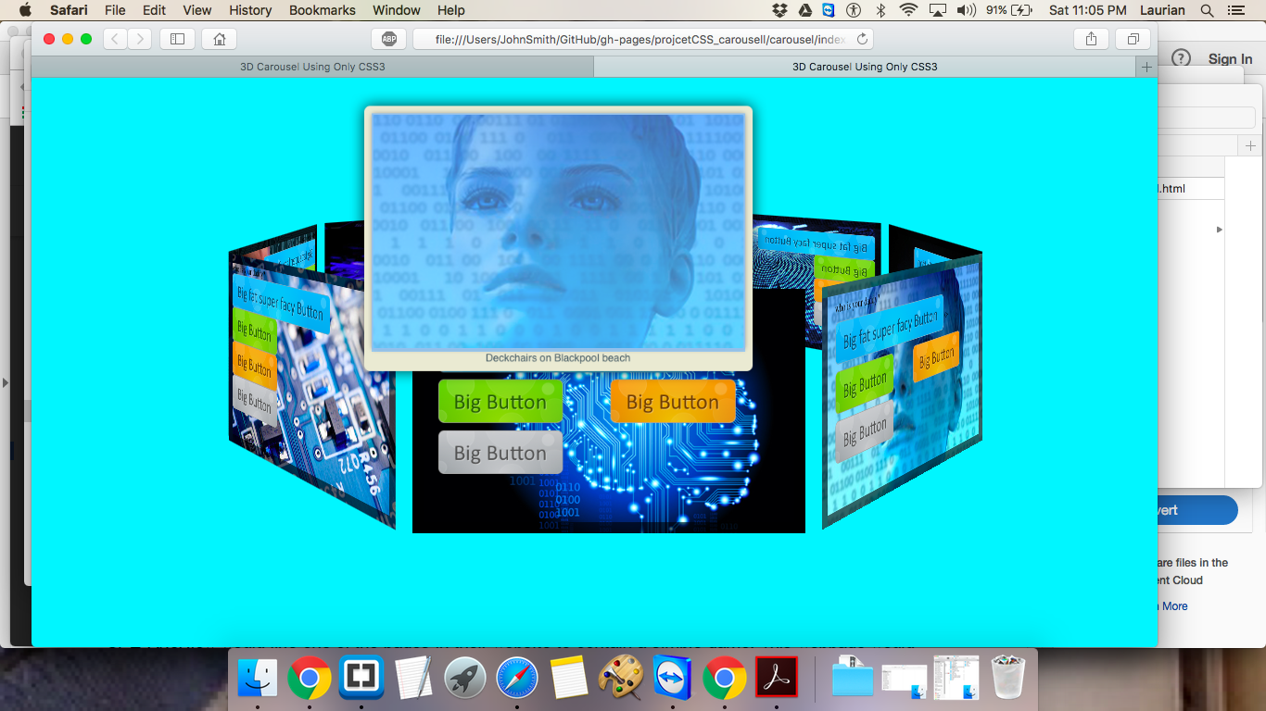
Technical problem encountered

Slide 12
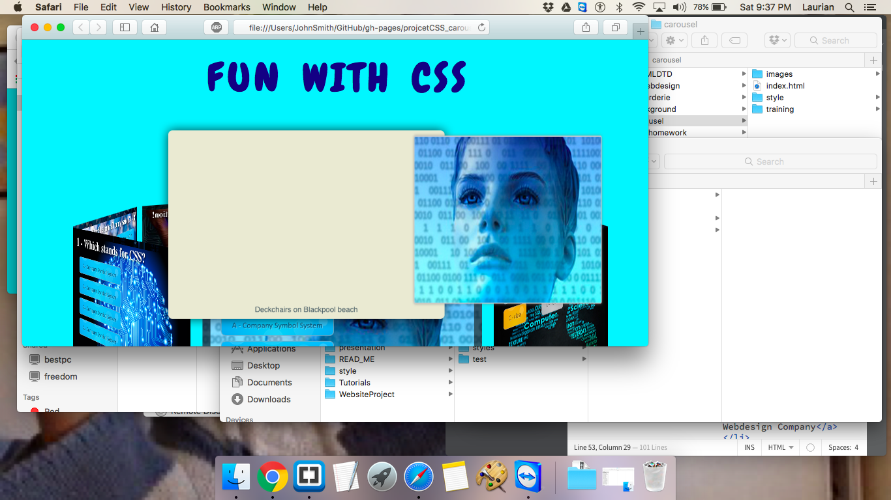
issues Rotating the octagon

Slide 13
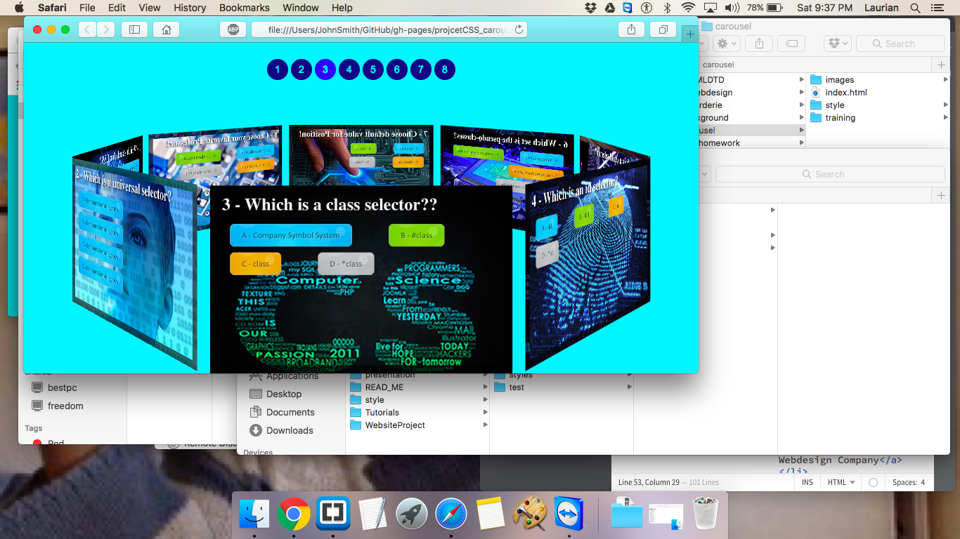
No pop out picture on the opposite side

Slide 14

Thank you for watching

